Slide 1
ONLINE TENDERING –
JAPANESE and DUTCH AUCTION –
SUPPLIER GUIDE
Düsseldorf
January 2024
Process Consulting Offer Solution:
Email: esourcing@sourcingsupport.de
Phone +49 211 969 4747
0 © METRO AG. Offer Sounding Board. For internal use only.

Slide 2
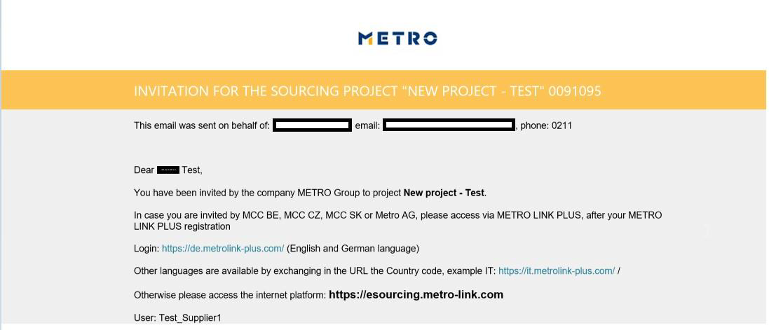
Introduction
You have been invited to participate in aJapanese / Dutch auction of Metro Group.
To submit your prices, you will be using the web-based eSourcingsoftware provided by METRO
Log-in: https://de.metrolink-plus.com/ (Other languages are available by exchanging in the
URL the Country code, example IT: https://it.metrolink-plus.com/ /)
For any technical questions concerning the platform please contact Offer Solutions Services:
Email: esourcing@sourcingsupport.de Phone +49 211 969 4747

Slide 3
How to Log-in in eSourcing via Metro Link Plus
After you finalized your registration in METRO LINK PLUS, you will have access to eSvia
METRO LINK PLUS:
Login: https://de.metrolink-plus.com/

Slide 4
How to access Metro Link Plus
After you finalized your registration in METRO LINK PLUS, you will be able to login via https://de.metrolink-plus.com/
The Login will require first a password and in the second step a Two factor authentication method

Slide 5
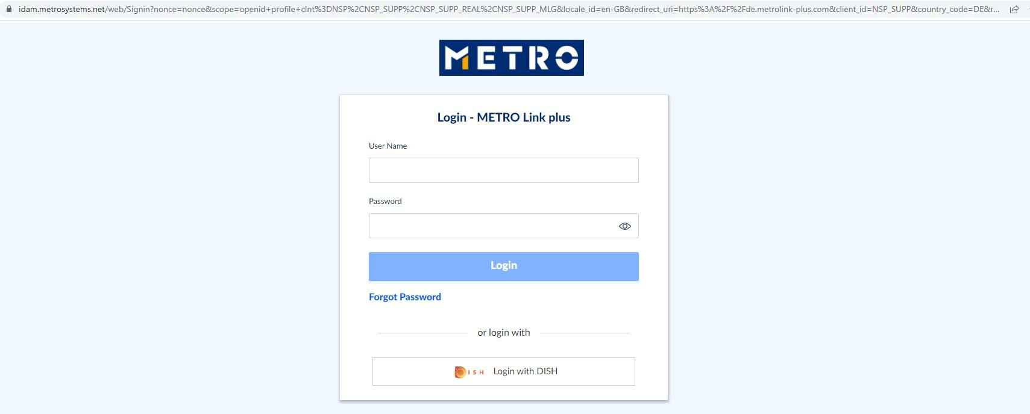
Login 1st step
Enter your email and your personalized password
If you forgot your password, please use the “Forgot password” functionality to get a new one.
If you are logging in for the first time or receive your password via email invitation,
you need to change and personalize your password.
When you set up your personalized password, please make sure that this will be a strong, complex one that will meet the security requirements.

Slide 6
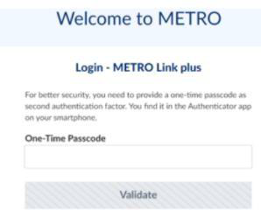
Login 2nd step
Two factor authentication with One-Time Passcode is needed for supplier user
due security reasons
If you login for the first time you will need to Setup your Two-Factor Authentication . Please click HERE for more instructions.

Slide 7
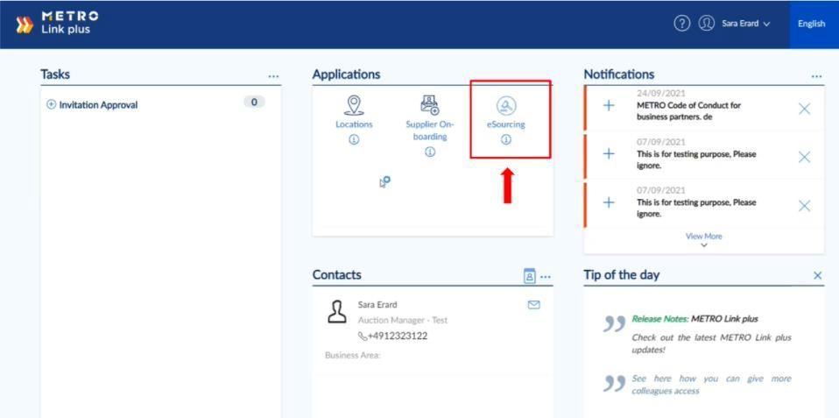
Access eSourcing Application
Once you entered in Metro Link Plus, please click on "eSourcing“ icon to enter the application for online tendering

Slide 8
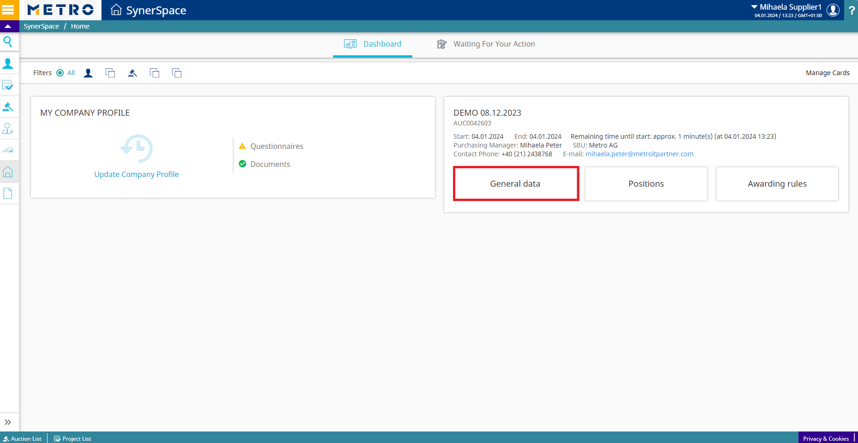
eSourcing HOME page
After clicking the eSourcing icon in Metro Link Plus, you will be redirected to eSourcing home page.
In this page you will see the projects and auctions you are invited to
Please click “General data” to access the Auction

Slide 9
Alternative way to find the Auction
You can also click on “Menu” and navigate to “Auctions”-”Auction List” to find the Auctions you are invited to
Or you can click Auction List on the bottom of your screen

Slide 10
How to open the Auction
Please click on the grey folder with “+” to open the Auction

Slide 11
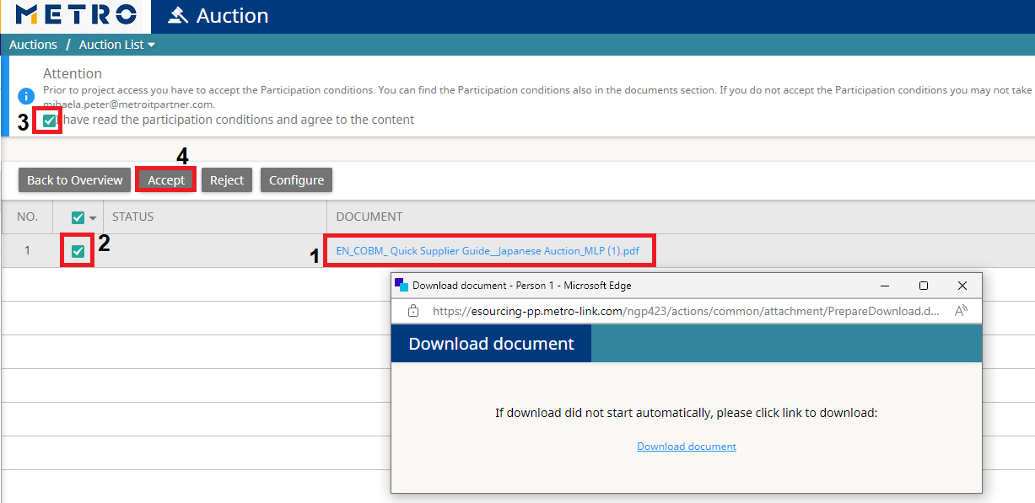
How to accept General Conditions
For you to be able to participate to the Auction you must accept the “General Conditions”
Please ensure you download, and open the documents set as GC (1)
In case of more than 1 document or in case of a zip file that contains many documents, it is still mandatory to download, open and accept all the documents.
Select all Document lines (2) , tick on “I have read the participation conditions”(3) and click on “Accept” (4).
Please read all documents carefully and be aware that once the documents are confirmed,
they are legally signed and don’t need to be manually signed. After this confirmation you are able to participate in the auction. In case you disagree with the content of the document, contact the buyer asap.

Slide 12
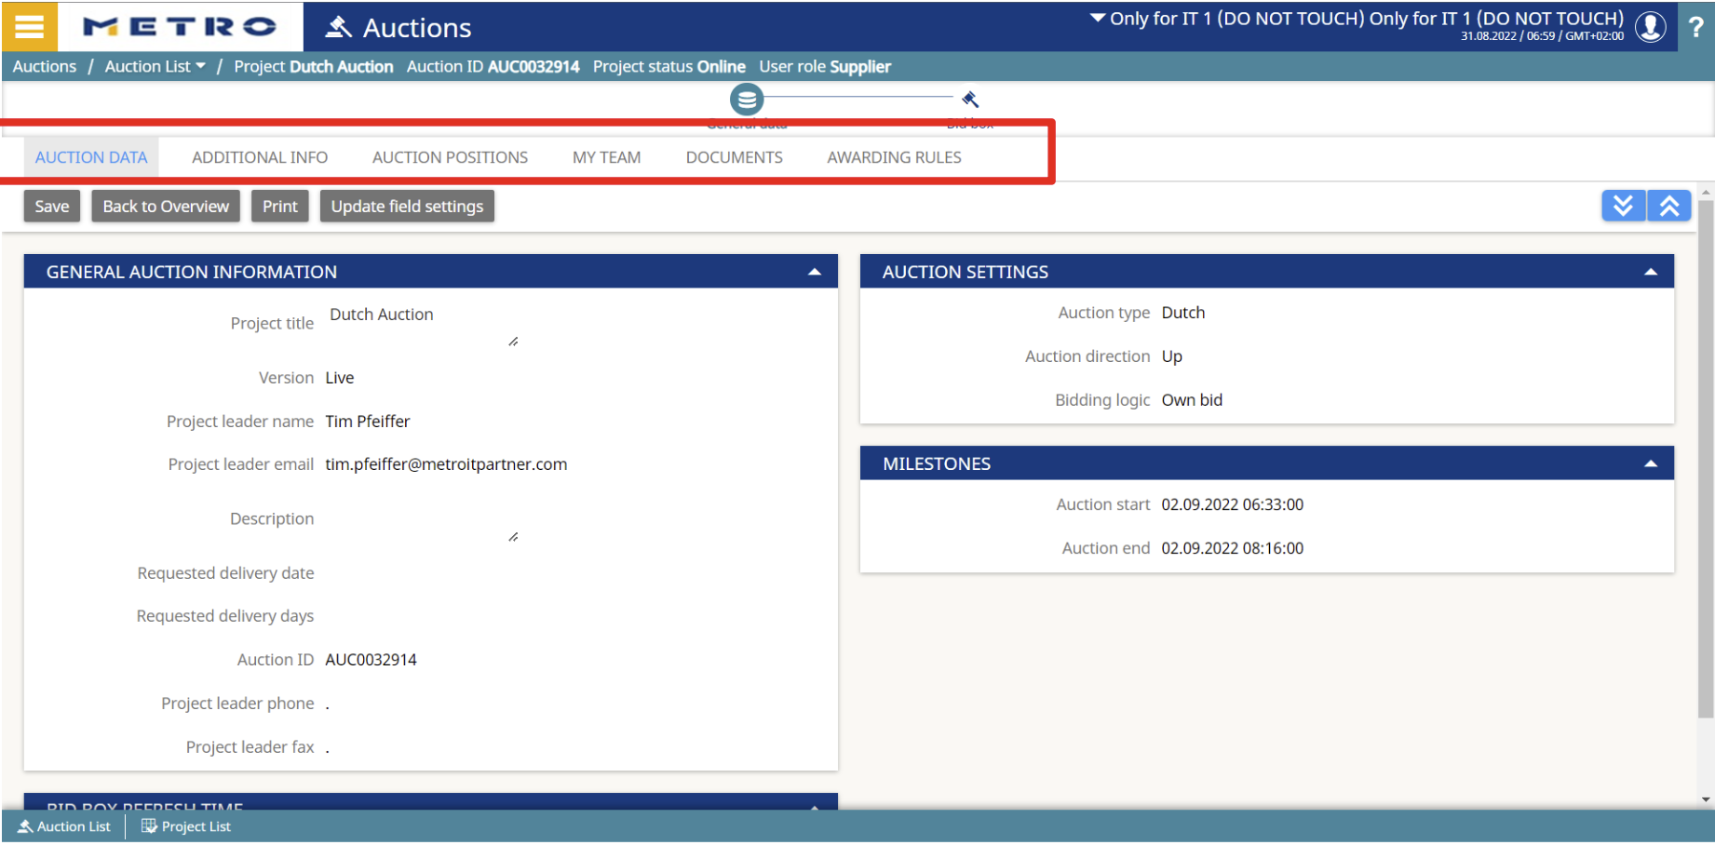
General Information
After accepting the general conditions, you will have access to the following tabs:
Auction data
Additional info
Auction positions: articles to be negotiated.
My Team: list of members of your company that are invited to the project.
Documents: list of tender documents available for you for the project

Slide 13
Where to find Documents
In tab “documents” you can download and upload documents:
To download the documents: select the document and click on “download” (1)
You are also able to upload documents which you would like to share with the buyer (2)

Slide 14
Auction rules for Japanese Auction
In a Japanese auction supplier will need to confirm the displayed value/price/current bid, to stay in the bidding process for current article. The bid direction is “down”. The buyer defines the starting price, the bid and the time decrement. Participants validate steps that are offered by the system to accept the current price and to stay in competition. Those who fail to validate will be automatically excluded from the Auction
During the auction, you can always see the following information:
◼ End time for the current step, Next bid step (price reduction for the next step), Remaining time before end of current step, Next step duration in minutes/seconds, Refresh rate (1)
◼ Current bid to be confirmed, Start price, own best bid shows the price you have just confirmed (2)
◼ When you agree with the current bid, please click on the green to confirm and then wait for the next change of the bid and see whether you would like to confirm the next price or not. To stay in the auction, you need to continue confirming the current bid till you reached your limit price. You are still bidding for current article when you have “remaining joker” left and your bidding status remain “active” (3)
◼ As soon as you stop confirming the current bid the auction ends for you for the current article

Slide 15
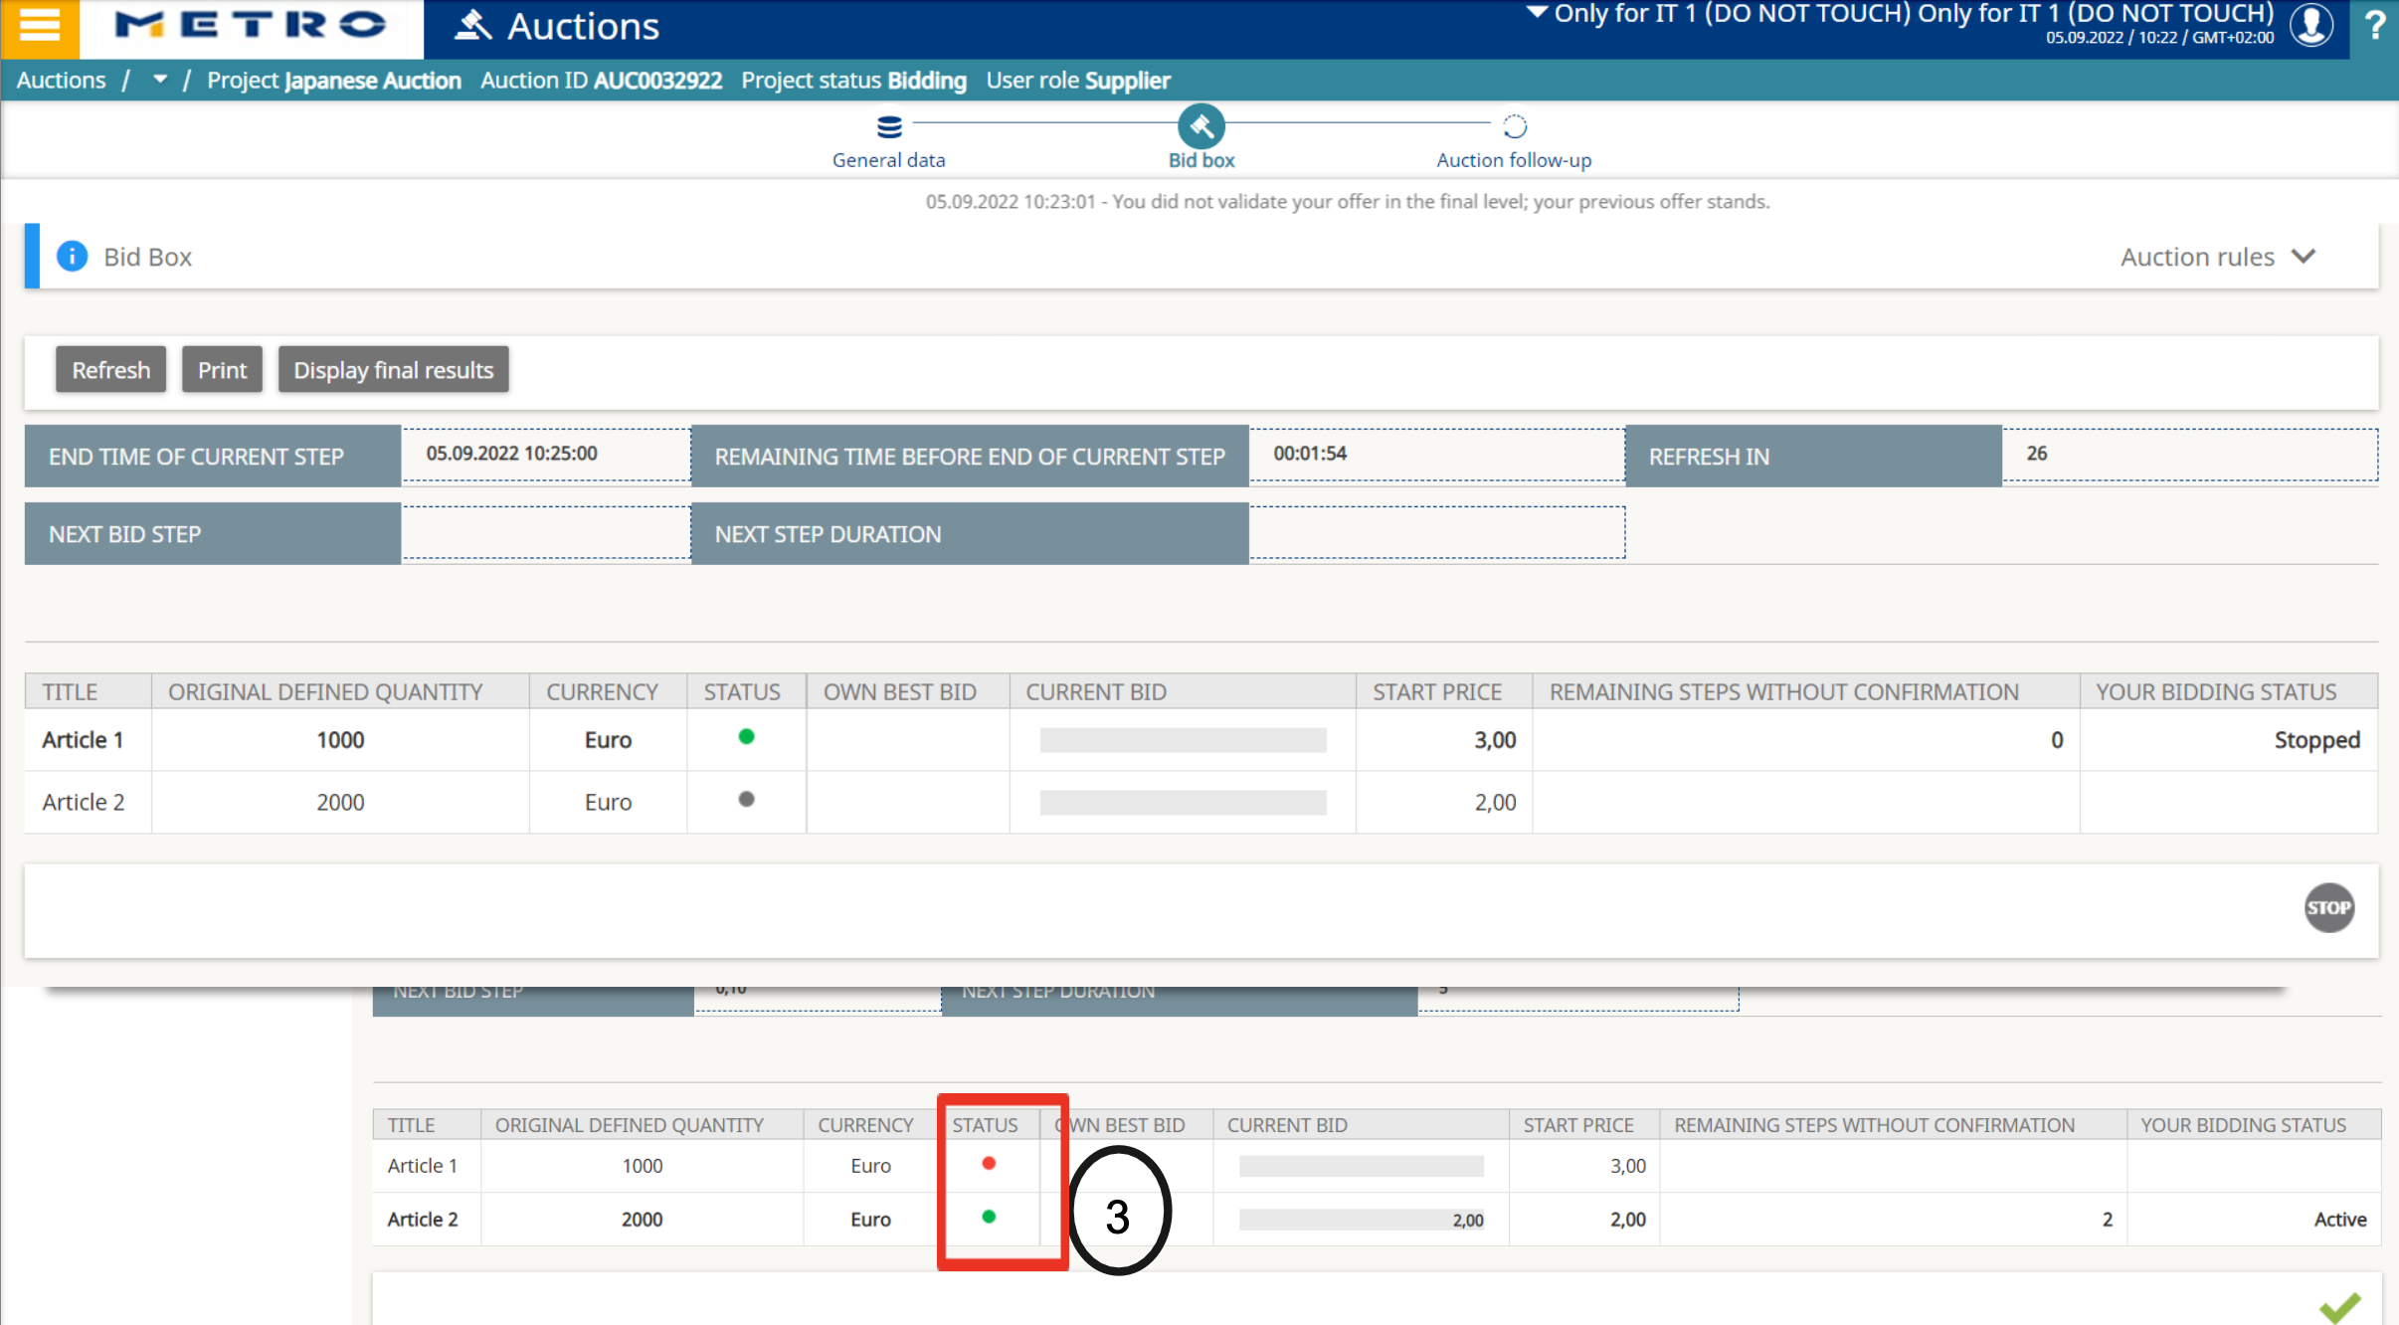
PLEASE BE AWARE
As soon as you stop confirming for the current bid , the auction ends for you for the current article and your bidding status turns “stopped”(1), you see a notice (2) and below a stop-sign. In this case you will have to attentively wait when the next article turns online (Status turns green), in order not to miss the start of bidding

Slide 16
Auction rules for Dutch Auction
The bid direction is “up”. The buyer defines starting price, bid steps and a reserve price. The auction will increase in price at each time step. As soon as the first participant agrees / accept the current price for the article, the auction ends for the current article. During the auction, you can always see the following information:
◼ End time of current step and Next bid step (price increase for the next step). Remaining time before end of current step and Next step duration, Refresh rate (1).
◼ Current bid to be confirmed, own best bid shows the price you have just confirmed (2)
◼ When you agree with the Current bid for the current article, please click on the green to confirm.

Slide 17
How to logout from eSourcing
Click here to logout from eSourcing:

Slide 18
How to Contact us
If you face technical issues during a live auction, please immediately contact your buyer.
If you need any support to use the eSourcingplatform, please do not hesitate in contacting:
Process Consulting Offer Solution esourcing@sourcingsupport.de Hotline: +49 211 969 4747
Mo. –Thu.: 08:00 to 18:00
Fri.: 08:00 to 16:00

