Slide 1
ONLINE TENDERING –RFP
REQUEST FOR PRICE –
SUPPLIER GUIDE
Düsseldorf
January 2024
Process Consulting Offer Solution:
Email: esourcing@sourcingsupport.de
Phone +49 211 969 4747
0 © METRO AG. Offer Sounding Board. For internal use only.

Slide 2
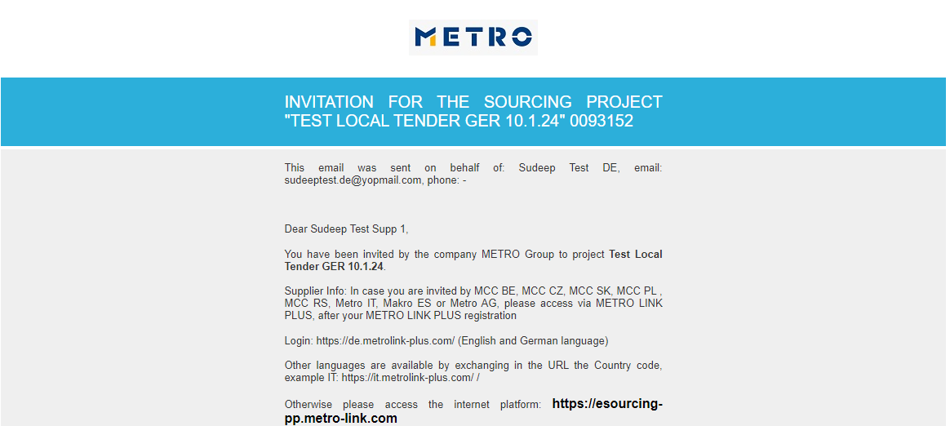
Introduction
You have been invited to participate in an RFP
To submit your prices, you will be using the web-based eSourcingsoftware provided by METRO
For any technical questions concerning the platform please contact Offer Solutions Services:
Email: esourcing@sourcingsupport.de Phone +49 211 969 4747

Slide 3
How to Log-in to eSourcing:
Log-in to eSourcing using one of the methods below:
Log-in via Metro Link Plus [Suppliers onboarded in MLP]
Other languages are available by exchanging in the URL the Country Code
Example: https://it.metrolink-plus.com/
Direct log-in via eSourcing [Suppliers not onboarded in MLP]
Please click here for more log-in instructions

Slide 4
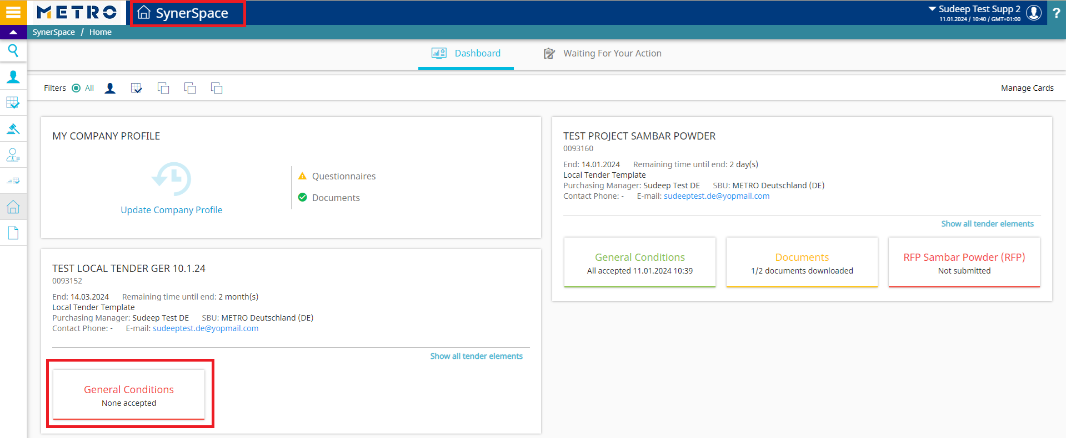
eSourcing HOME page - Synerspace
You will see on the home page your projects that you are invited to
Here you will find the General Conditions (GC) tab
General Conditions coloured in green it means that you already accepted the GC
General Conditions coloured in red it means that you did not accepted yet the GC

Slide 5
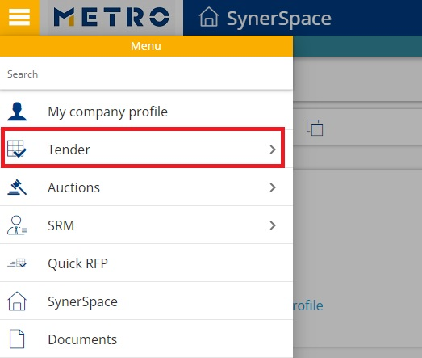
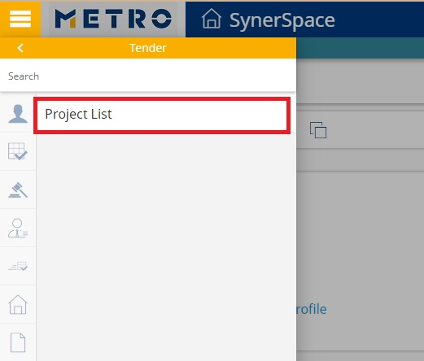
How to Find a project
You can find your project in Tender-Project list
You can find the project in SynerSpace
Notes:
You have 3 options to find projects where you have been invited to:
-Please click on „Tender-Project list“ module to find the list of all projects where you have been invited to.
-Click on “SynerSpace” under Favorite apps RFX
- You can also find the projects, where you are invited to at: „Thinks going on“ or „next tenders / auctions“

Slide 6
How To access the project
Click on the blue arrows to find the Open action icon
Click on the grey Open folder to open the project

Slide 7
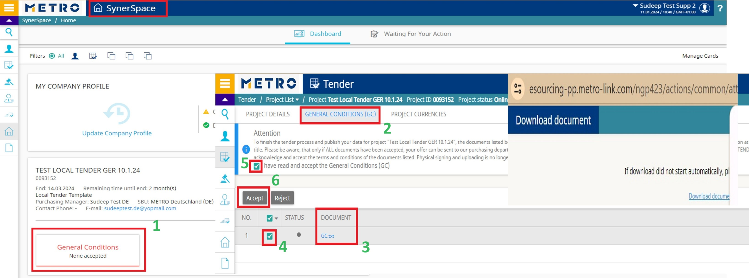
How to Accept the general conditions
Before you will be able to access the tender, you will need to accept the General conditions
Click on General Conditions
Click on the document/documents set as GC to download them.
In case of more than 1 document or in case of a zip file that contains many documents, it is still mandatory to download, open and accept all the documents.
Select all documents lines
Make a check mark/tick on “I have read and accept the General Conditions (GC)”
Click on Accept

Slide 8
Where to Find the General Information
After accepting the General Conditions, you will have access to the following tabs:
Project Details: contains general information on the project
Project Currencies: the currency of the project
My Team: list of members of your company who are invited in the project
Documents: list of tender documents
Tender Elements: access to the price request

Slide 9
Where to Find the Documents
Documents are found under Documents tab
Click on Download icon to download the needed document or
Select the document ☑ and click on the activated Download icon
Please note that you are also able to upload documents, which you would like to share with buyer with the Upload icon
Notes:
- It it also possible to create new folder or filter through the published documents

Slide 10
How to place values in the tender
Click on Tender elements tab
Click on the blue arrows to see the action icon
Click on Place values icon

Slide 11
How to enter and Publish your prices
Ener your prices
Click on Save as draft
Click on Publish all tabs to send your answers to the buyer
You can use Export and then Import icons to insert your prices via excel
You can change your answers while the project status is Online
You can Logout from eSourcing

Slide 12
How to Contact us
If you face technical issues during a live auction, please immediately contact your buyer.
If you need any support to use the eSourcingplatform, please do not hesitate in contacting:
Process Consulting Offer Solution esourcing@sourcingsupport.de Hotline: +49 211 969 4747
Mo. –Thu.: 08:00 to 18:00
Fri.: 08:00 to 16:00

